Slide 1
Objective: to set up their automation environment, write and debug Selenium test scripts, handle various web elements, and apply the Page Object Model (POM) design pattern.
Web Automation with Selenium
By:
Nitish Mahant

Slide 2

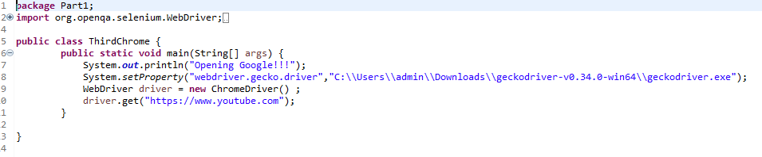
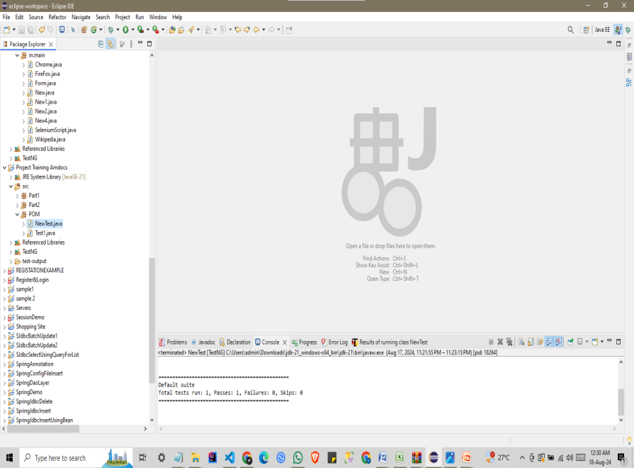
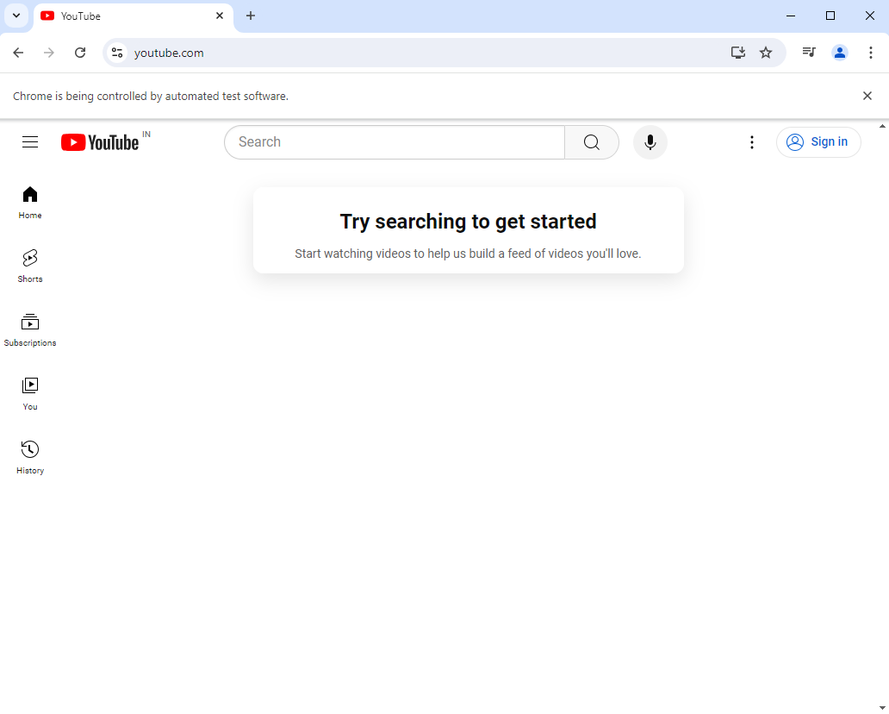
Eclipse IDE
Java WebDriver for Firefox and Chrome browsers
Output

Slide 3
XPath and CSS Selectors
Xpath is bidirectional you can traverse elements from parent to child or child to parent
Use:
Heavily used in development - JQuery is heavily reliant on CSS
Can do almost everything an XPath expression can do
Targeting elements in a shadow DOM - elements within a shadow DOM cannot be targeted with XPath
CSS selector is unidirectional you can only traverse from parent to child
Use:
Finding an element by text
Locating a parent element by using a child element

Slide 4
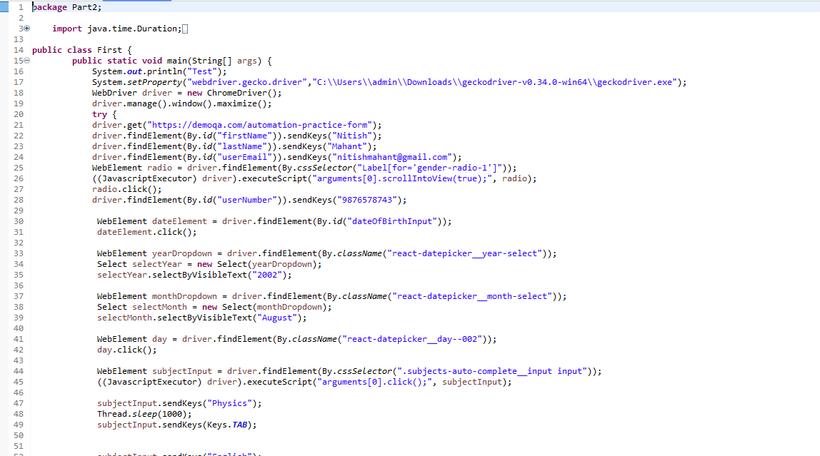
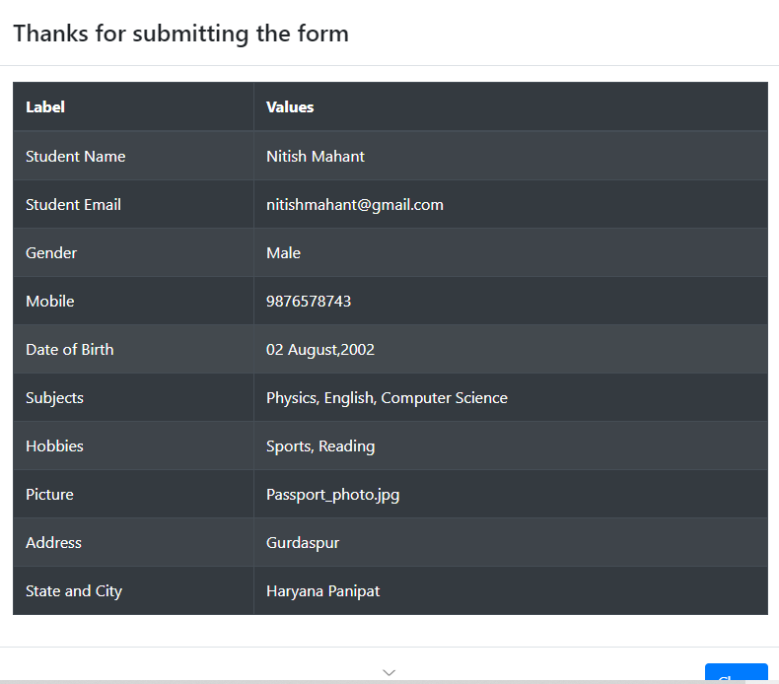
DemoQA Forms page
Output

Slide 5
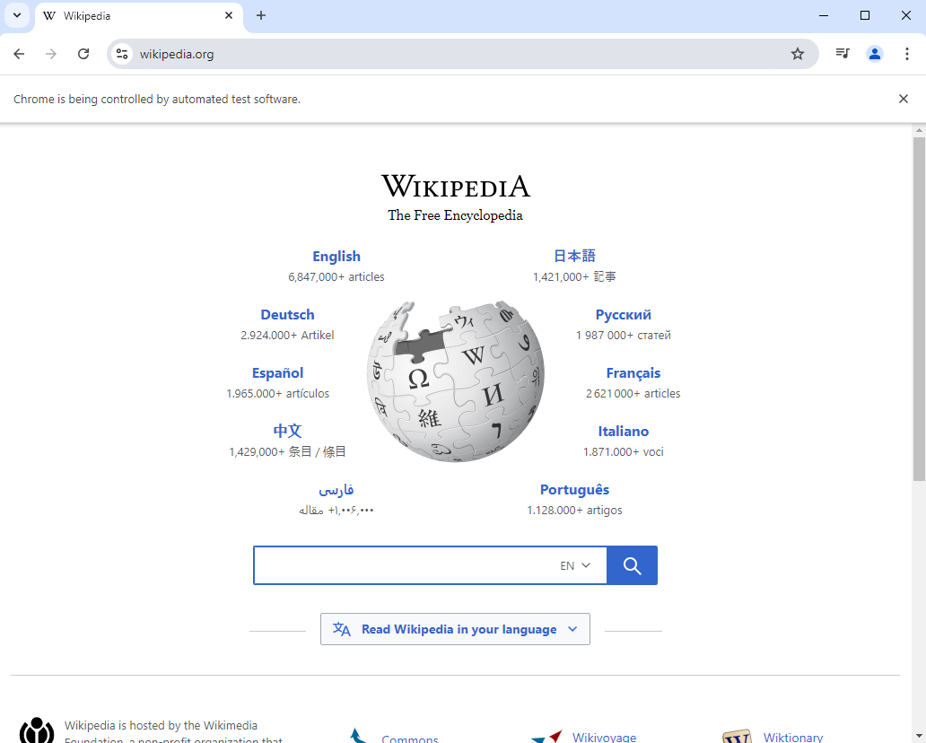
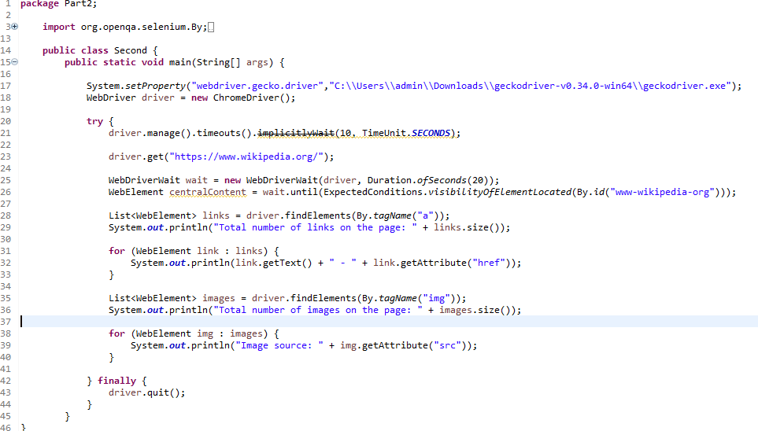
Extract all links and other web elements from the Wikipedia Main Page
Free media collection - https://commons.wikimedia.org/
Wikivoyage
Free & open wiki software - https://www.mediawiki.org/
Wikisource
Free content library - https://www.wikisource.org/
Wikispecies
Free species directory - https://species.wikimedia.org/
Wikifunctions
Free function library - https://www.wikifunctions.org/
Meta-Wiki
Community coordination & documentation - https://meta.wikimedia.org/
Creative Commons Attribution-ShareAlike License - https://creativecommons.org/licenses/by-sa/4.0/
Terms of Use - https://meta.wikimedia.org/wiki/Terms_of_use
Privacy Policy - https://meta.wikimedia.org/wiki/Privacy_policy
Total number of images on the page: 1
Image source: https://www.wikipedia.org/portal/wikipedia.org/assets/img/Wikipedia-logo-v2.png

Slide 6
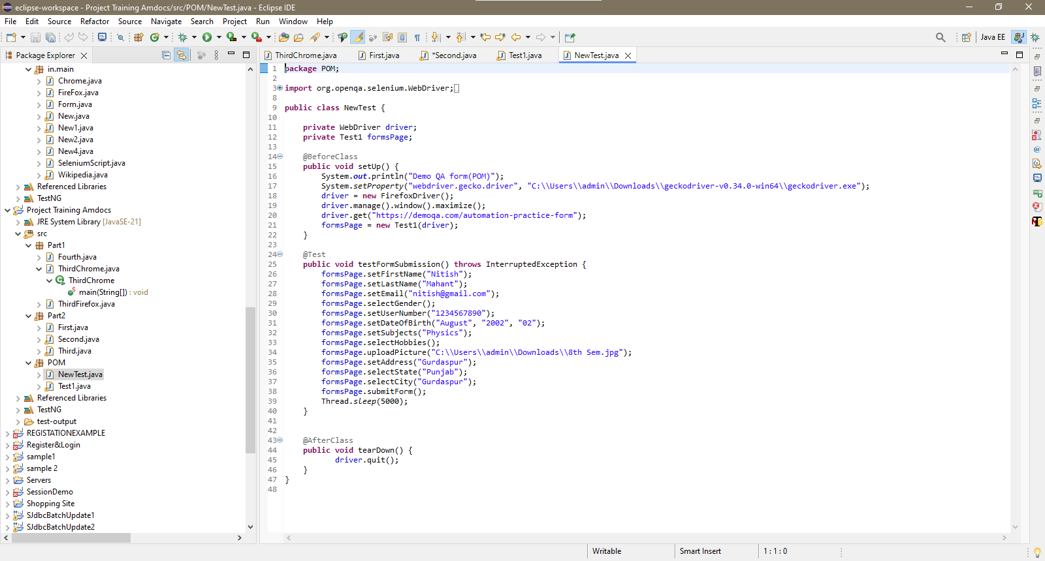
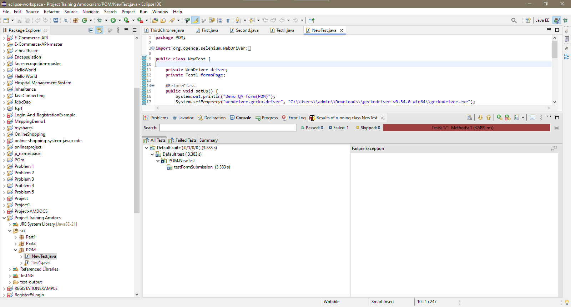
Refactor existing scripts to use the Page Object ModelRefactor existing scripts to use the Page Object Model

Slide 7
Thank you

